Slide 1


Ontario Benchmark Project
Determination of alpha and beta characteristics of key commercial hop varieties
Project Presentation
Presented on November 27, 2015
Prepared by: José Gabrie
Funded by:

Slide 2
Introduction
Project Overview & Goals
Guidelines
Results and Discussion
Conclusion

Slide 3
Introduction
Research Team
David Ly, Research Associate (Lead)
Darcy Devereaux, Research Assistant
Robert Doyle, Faculty Lead
José Gabrie, Lab Technologist
Kristine Canniff, Acting Project Manager

Slide 4
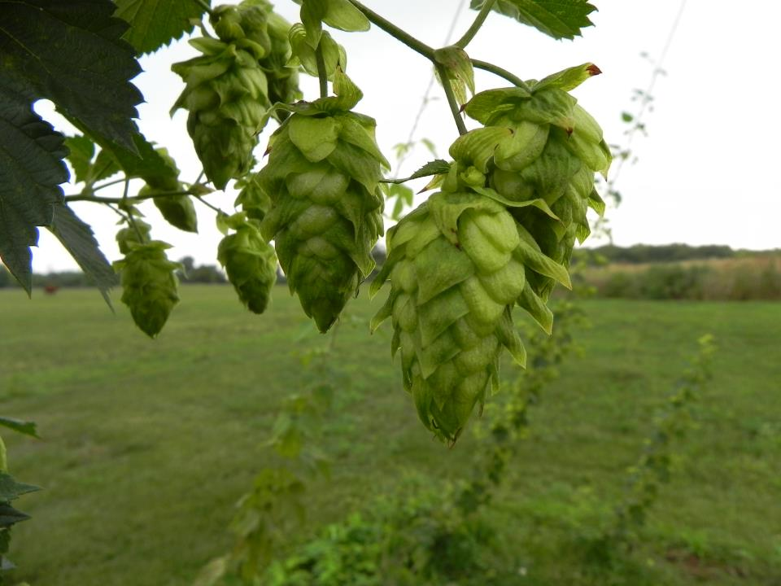
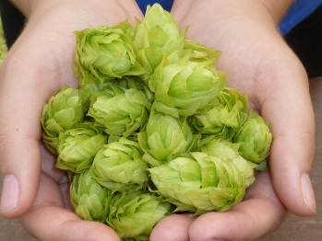
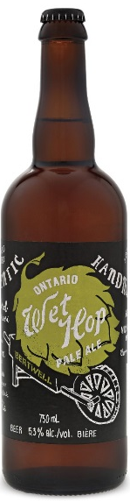
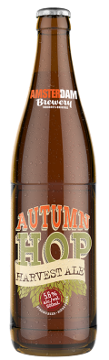
Project Overview & Goals
Help OHGA in establishing benchmarks for Ontario grown hops
  What is an Ontario hop?
  What are the alpha and beta characteristics on key commercial varieties when grown in Ontario?

Slide 5
Guidelines
Hop samples:
  Mature cultivars (over 3 years)
  Hop cones harvested during 3 time periods
      Early-season (Aug. 10-21),
      Mid-season (Aug. 24-28) and
      Late-season (Sep. 7-11)
  Representative samples of each harvest time taken and dried (about 10% moisture)
  At least 50 g of dried samples shall be packed and sent to NC
      Light protected –ideally, vacuum sealed
      Properly labeled
      Shipped to NC as soon as possible

Slide 6
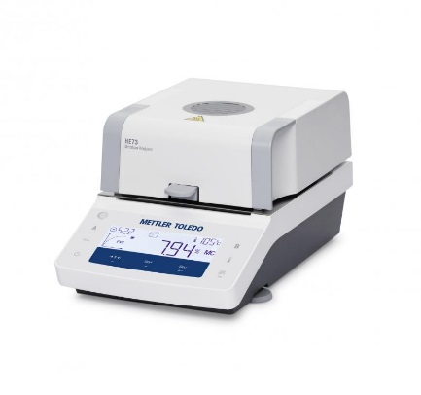
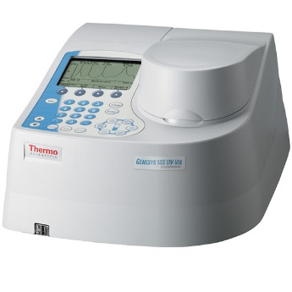
Guidelines
Analytical Tests:
According to the American Society of Brewing Chemists (ASBC)’s protocols
  Moisture content (%)
    ASBC_Hops-4C
    Automated moisture analyzer (MT-HE73)
  Alpha and Beta-acids content (%)
    ASBC_Hops-6A (UV Spectrophotometry)
  Hop Storage Index (H.S.I.)
    ASBC_Hops-12

Slide 7
Sample reception
- Code
- Gross weight
Sample storage
- Freezer (-20 °C)
Lab testing
- Room temp.
- Net weight
Aliquot for moisture analysis
Aliquot for grinding
α & ß-acids content
H.S.I.
Process Flowchart

Slide 8
Results and Discussion

Slide 9
A. Samples

Slide 11
B. Moisture content (%)
Largest variability
Range: 3.06 to 46.23 % (M= 13.74, SD = 9.83).
Hop color was significantly associated to moisture content
  Green-yellowish hops: M= 9.85, SD = 3.99
  Brown hops: M= 26.71, SD = 12.94
Brown hops lacked the characteristic aroma (impact on essential oils content?)

Slide 12
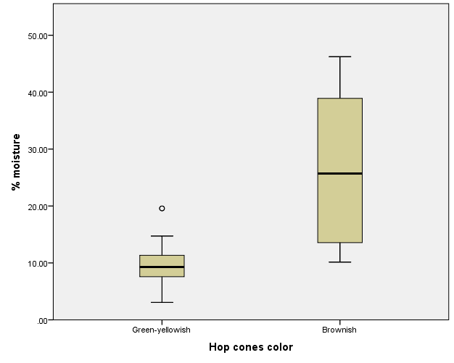
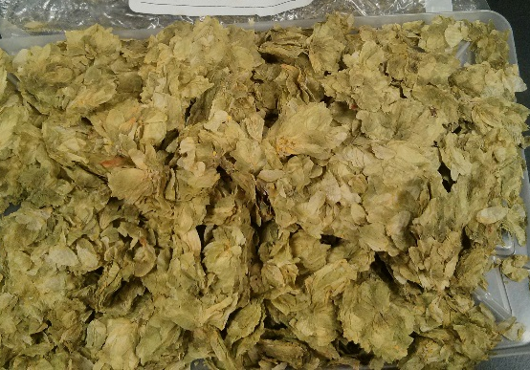
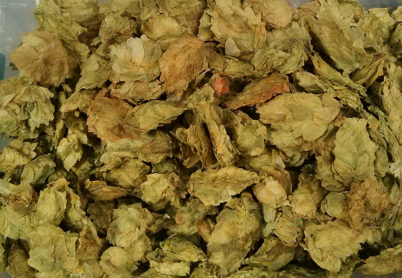
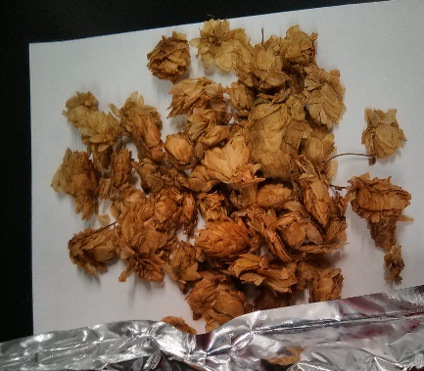
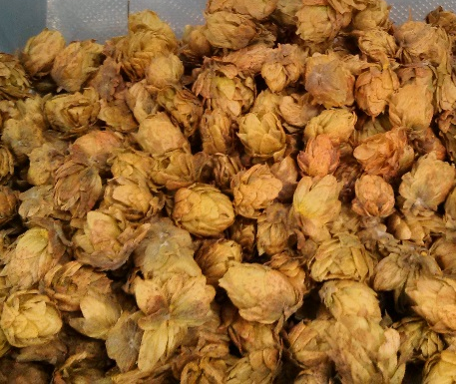
M = 26.71 %
M = 9.85 %
8.24 % moisture
8.63 % moisture
28.85 % moisture
46.23 % moisture

Slide 13
C. Hop Storage Index
GOOD keeper
≤ 0.22
?????
0.23 – 0.25
POOR keeper
≥ 0.26
38 %
42 %
20 %
H.S.I. vs. α-acids % not possible due to sample size
Moisture content was inversely correlated to H.S.I. value and would explain only 25% of its variation

Slide 14
D. Content of α and ß-acids (%)
Mean values of α-acids were in the expected range (except in Mount Hood)
VARIETY | α %‡ | SD | β %‡ | SD
Cascade | 5.25 | 1.42 | 5.82 | 0.88
Centennial | 10.08 | 1.49 | 4.41 | 0.89
Chinook | 11.74 | 1.34 | 3.18 | 0.30
Fuggles | 4.48 | 0.78 | 3.52 | 0.73
Hallertauer | 4.70 | 2.08 | 2.83 | 0.44
Mount Hood | 4.32 | 1.28 | 5.85 | 0.80
Nugget | 11.87 | n/a | 4.72 | n/a
Saaz | 4.57 | 0.85 | 4.74 | 0.89
Willamette | 4.23 | 0.67 | 4.56 | 1.25
‡ Mean values; SD = Standard deviation. Outlier values were not considered in the calculation.

Slide 17
2014
2014
2011
2010

Slide 20
Conclusions

Slide 21
Baseline data of α and ß-acids content in some hop varieties being grown in Ontario is provided. Nevertheless, data should be interpreted with caution.
Moisture content in samples was significantly associated to brown color in hop cones and pellets although this did not negatively affected the Hop Storage Index. More investigation is needed to evaluate potential impact on essential oils content.

Slide 22
Content of α-acids was according to the expected reference values in almost all varieties.
To explore differences in α-acids content according to the harvest season and crop location, a larger and better distributed sample is needed. Hop cones should be the only format tested.
OHGA’s members should be certain of which hop variety they are growing at their farms.

Slide 23
Thank you for partnering with us, it was a pleasure working with you!
The Research & Innovation Team

Slide 24

For more information visit: NiagaraCollege.ca/Research
SOLUTIONS FOR INDUSTRY
Providing innovation solutions to business and industry through applied research in partnership with Niagara College faculty and students.
For more information or if you have a project lead contact:
Kristine Canniff – Industry Liaison Officer
kcanniff@niagaracollege.ca

